Slide 1
ELSIE Framework for Sensitization Assessment of E&Ls and Practical Application
September 22, 2022

Slide 2

Introduction
Patricia Parris
Global Risk Assessment Services Toxicologist
Pfizer, Inc.

Slide 3
ELSIE Leachables Risk Management Approach
www.elsiedata.org/elconcepts

Slide 4
Risk Control – Safety Assessment White Paper
Objective - Consolidate information related to toxicity of E&L and propose safety evaluation process flow based on understanding toxicities (including mutagenic potential)
  Build on concepts in existing documents, e.g., ICH M7, ICH Q3A/B/C/D, PQRI, FDA
  ELSIE publications Broschard et al 2016; Parris et al, 2020, Masuda-Herrara et al., 2022, Parris et al 2022
Highlights areas where further harmonized guidance is needed:
  Default parenteral thresholds for compounds with limited toxicological data (Masuda-Herrara et al., 2022)
  Evaluating endpoint-specific effects (e.g., irritation, sensitization Parris et al, 2022)
Application of M7 principles to E&L inconsistent
  Route of administration and bioavailability considerations
  (non-daily) dosing and less than lifetime (LTL) limits for non-mutagenic substances
Risk assessment of polymers

Slide 5

ELSIE Sensitization Workstream
Geraldine Whelan
Computational Toxicologist
GSK

Slide 6
Risk Assessment (e.g. of E&Ls)
Sensitization & Irritation Potential
Exposure Assessment
Hazard Identification
Hazard Characterization
Risk Assessment

Slide 7
Sensitization Assessment of E&Ls
Sensitization potential of E&Ls is complex from both a biological and risk assessment perspective
  Prevention of induction of sensitization
Sensitization following dermal, respiratory and oral exposure has been studied, and provides potential approaches for drugs administered by these routes
  Dermal Sensitization Thresholds and Quantitative Risk Assessment (QRA)
  Lack of validated animal models and complex biology precluded development of predictive tools for respiratory and systemic sensitization
  Local Lymph Node Assay (LLNA) – skin sensitizers (can detect respiratory sensitizers)
    Activation of the immune system regardless of route of administration – surrogate for parenteral administration
Further guidance needed on how to risk assess low level E&Ls with known or unknown sensitizing potential via parenteral routes of administration
  ELSIE workstream set up to establish best practice

Slide 8

ELSIE Sensitization Workstream
Objectives:
  Extract sensitization data from safety reports in ELSIE database
        Relevant chemical space
  Evaluate ELSIE sensitization potency with in silico tools
        How many are skin sensitizers? How potent?
  Scientific justification for threshold limits
        Do the data support existing limits? Another approach?
Notes:
Key point – because of material screening and selection not expecting high prevalence of potent skin sensitizers

Slide 9

Practical Application for Sensitization Assessment
5 µg/day recommended qualification threshold for sensitization/irritation (PQRI, 2007 and 2021)
  Conservative threshold
  Derived based on 150 inhaled compounds primarily with regulatory agency chronic reference doses (RfDs) – sensitization endpoint not evaluated
  Total inhaled dose assumed 100% deposition
  Scientific basis of application to parenteral route not substantiated
Challenges
  Large volume parenterals
  Lack of systemic sensitization data
Considerations
  Material characterization
  In silico tools for prediction of sensitization potential
  Incorporate skin sensitization potency into the assessment

Slide 10
Sensitization Assessment Framework:
Science-driven risk-based approach to E&L sensitization assessment

Slide 11
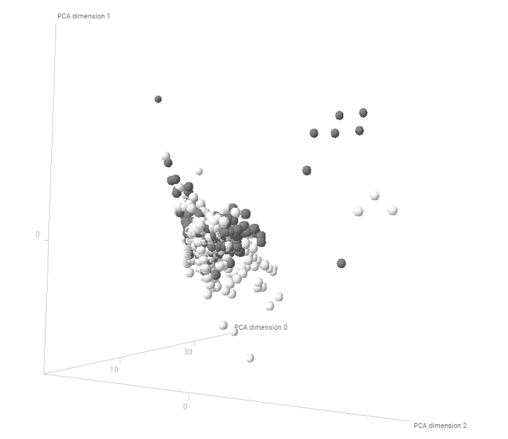
Topical Products
Good overlap between ELSIE and Dermal Sensitization Threshold (DST) compounds based on physicochemical properties:
  Molecular weight
  Lipophilicity
  Polar surface area
DST cluster contains neomycin – not relevant to E&Ls
Use DST for sensitization assessment of E&Ls in topical drug products
488 ELSIE compounds – light grey
387 DST compounds – dark grey

Slide 12
E&L Sensitization Assessment in Inhalation or Parenteral Drug Products
1. In silico structural assessment and
literature review for available data
2. Presence of reactive domain and/or HPC
- Convert EC3% to a dose (µg/day) and conduct compound-specific MoE assessment
3. Weak, moderate or negligible risk of inducing sensitization -
Tox assessment based on other endpoints

Slide 13

Acknowledgements
Thank you!
ELSIE Workstream Members
Patricia Parris (Pfizer) Sensitization Co-Chair
Geraldine Whelan (GSK) Sensitization Co-Chair
Shawn Bairstow (Baxter)
Joel Bercu (Gilead)
Uma Bruen (Organon)
Anders Burild (Novo Nordisk)
Courtney Callis (Eli Lilly)
Jessica Graham (Genentech)
Troy Griffin (Teva)
Jedd Hillegass (Bristol Myers Squibb)
Esther Johann (EMD Serono)
Claire Kent (AstraZeneca)
Agnes Koenig (B. Braun)
Martin Kohan (AstraZeneca)
Kim Li (Amgen)
Elizabeth Martin (AstraZeneca)
Alina Martirosyan (B Braun)
Melisa Masuda-Herrera (Gilead)
Constanca Porredon-Guarch (B Braun)
Matthew Schmitz (Takeda)
Brad Stanard (Ultragenyx)
Eric Tien (Biogen)
Jessica Whritenour (Pfizer)

Slide 14

ELSIE Sensitization Data and Threshold Analysis
Martyn Chilton
Principal Scientist
Lhasa Limited

Slide 15
What do we know about the potency of E&Ls?
Based on the chemicals in the ELSIE database:
  80% of E&Ls are non-sensitizers
  17% of E&Ls are weak/moderate sensitizers
  3% of E&Ls are strong/extreme sensitizers
Various thresholds are used for E&Ls including:
  ICH M7’s mutagenic TTCs: 1.5, 10, 20 and 120 µg/day
  ELSIE’s non-mutagenic TTCs: 35, 110 and 180 µg/day
How do these TTCs compare to the known potency of E&Ls?
  Quantitative estimates of potency are required (i.e. EC3 values)
Notes:
We know that very few E&Ls are strong/extreme sensitizers, based on the data available in the ELSIE database
There are also various TTCs available, including ICH M7 TTC and LTL variants, and ELSIE parenteral TTC and LTL variants which can be used for for E&Ls
Would be good too compare these to the sensitization potency of E&Ls but difficult when dealing with qualitative potency categories
Therefore we need a quantitative measure of potency (e.g. EC3 values)

Slide 16
Collecting quantitative dermal potency data
START
ELSIE database
463 compounds
Negative
Classification based on in vivo animal or human data
No data
Positive
207 non-sensitizers
55 sensitizers
201 compounds
Experimental EC3 values
taken from LLNA data
30 compounds with no experimental EC3 values
25 compounds with experimental EC3 values
39 compounds with dermal potency information
Predicted EC3 values
taken from Derek Nexus
16 compounds with no predicted EC3 values
14 compounds with predicted EC3 values
Notes:
The 463 chemicals in ELSIE DB were classified based on the available data into non-sensitizers (207), sensitizers (55) and those without data (201)
The 55 sensitisers were checked for LLNA data, and 25 EC3 values were located
For the remaining 30 sensitisers, an in silico analysis using Derek Nexus was performed to predict EC3 values where possible
This model uses an alert-based k-NN approach to read across EC3 values from mechanistic analogues
14 further EC3 were values gathered this way
Final dataset contains 39 chemicals with EC3 values: 25 experimental and 14 predicted

Slide 17
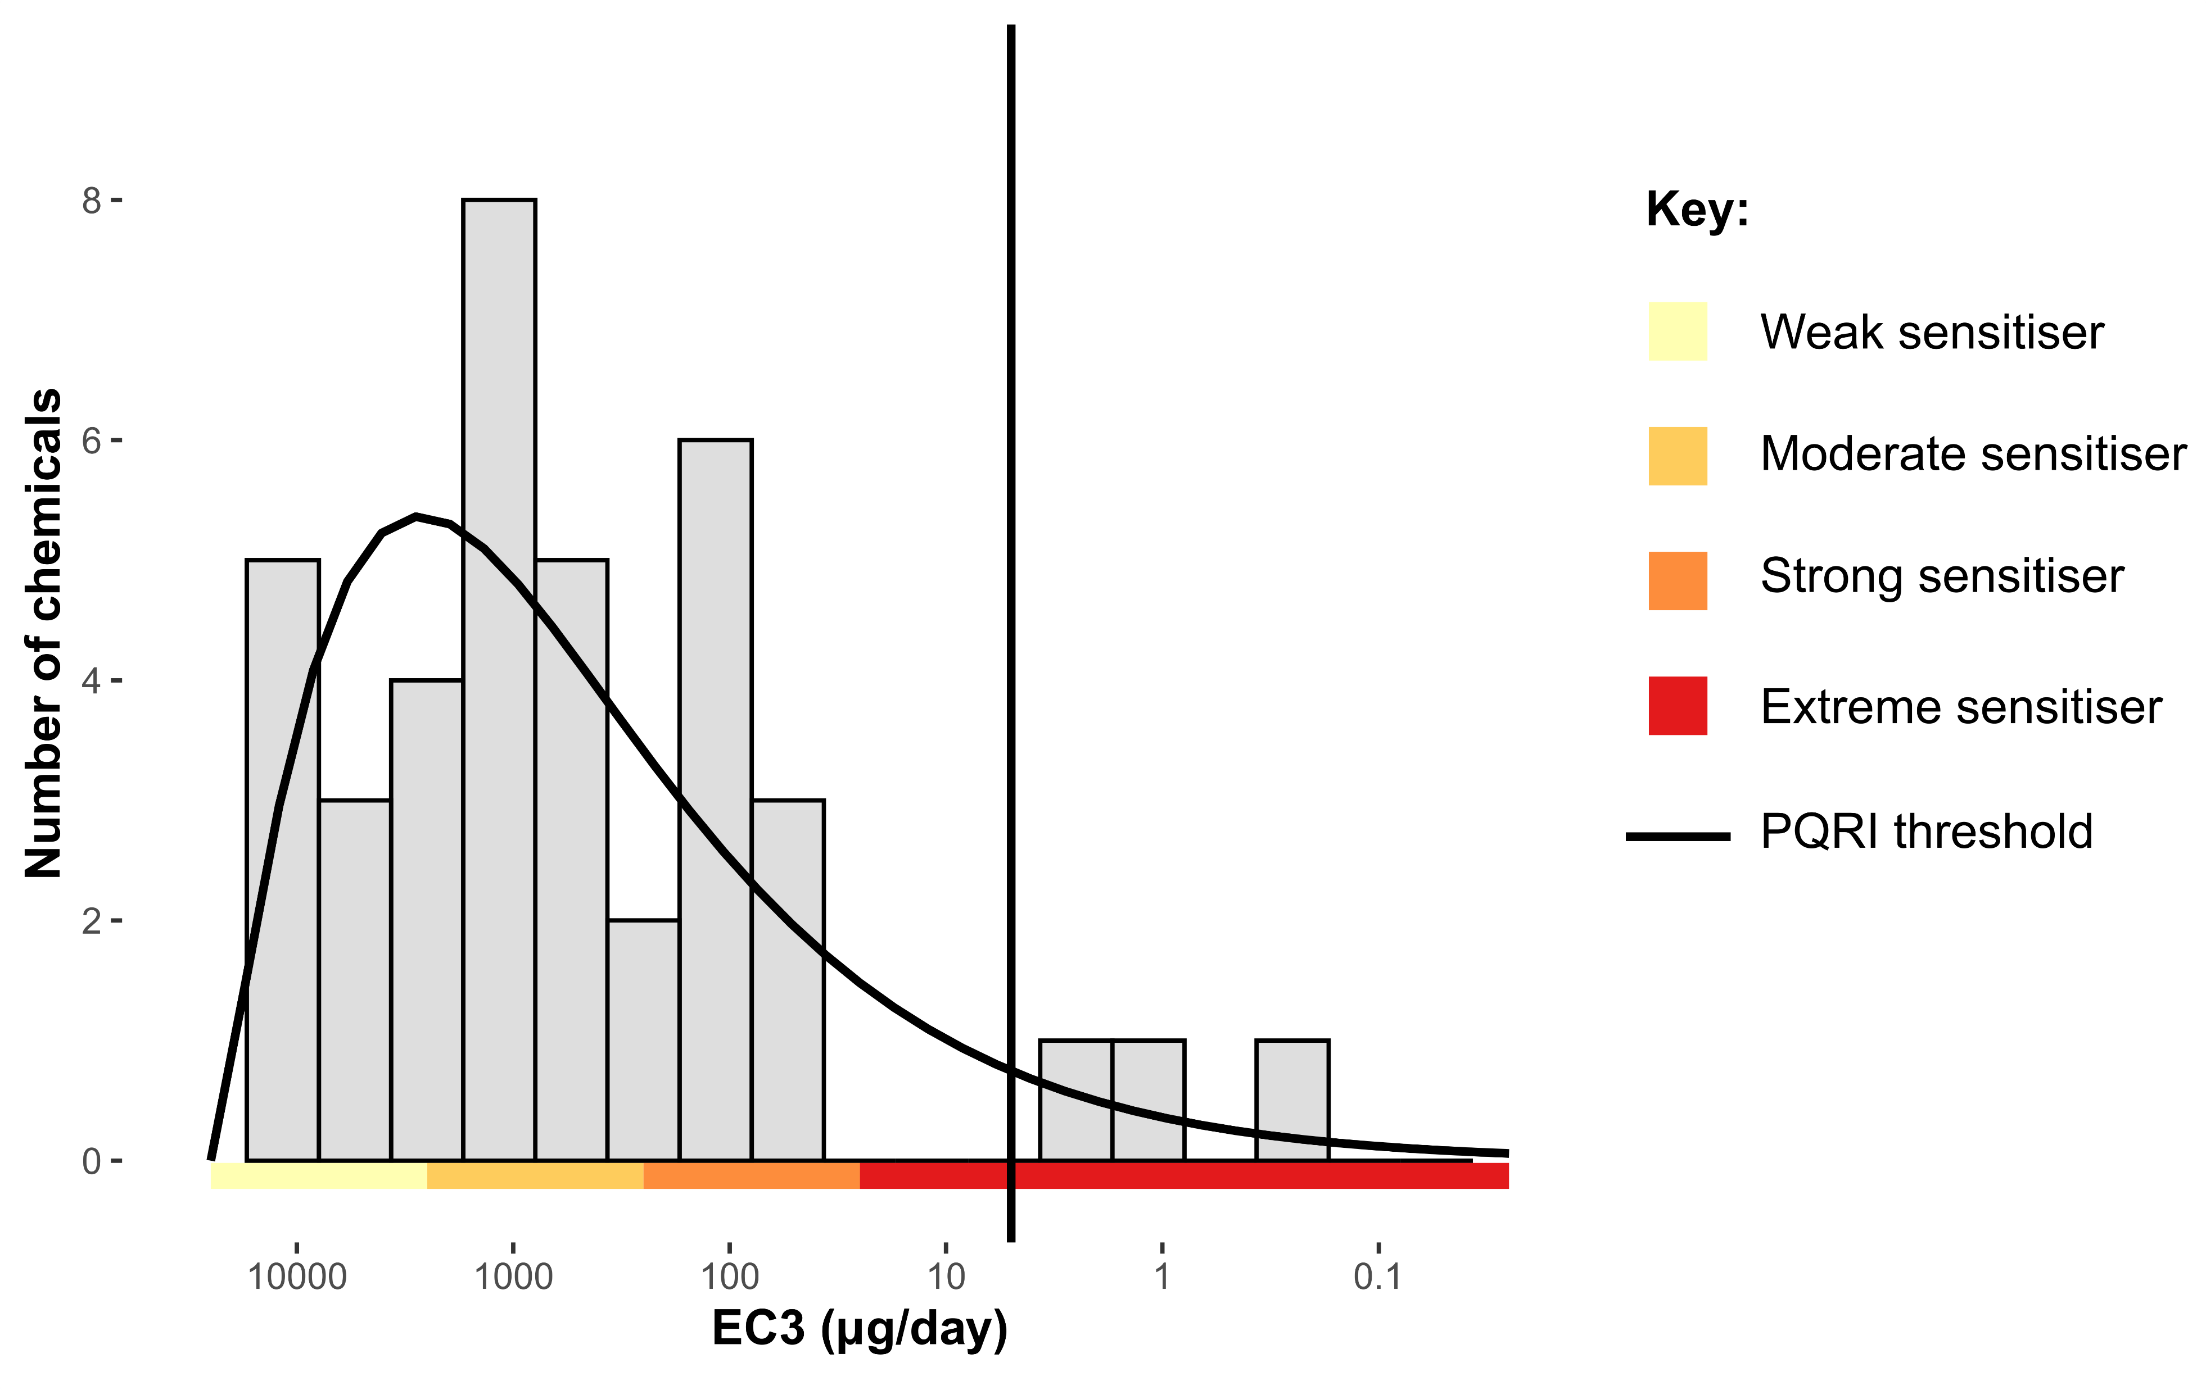
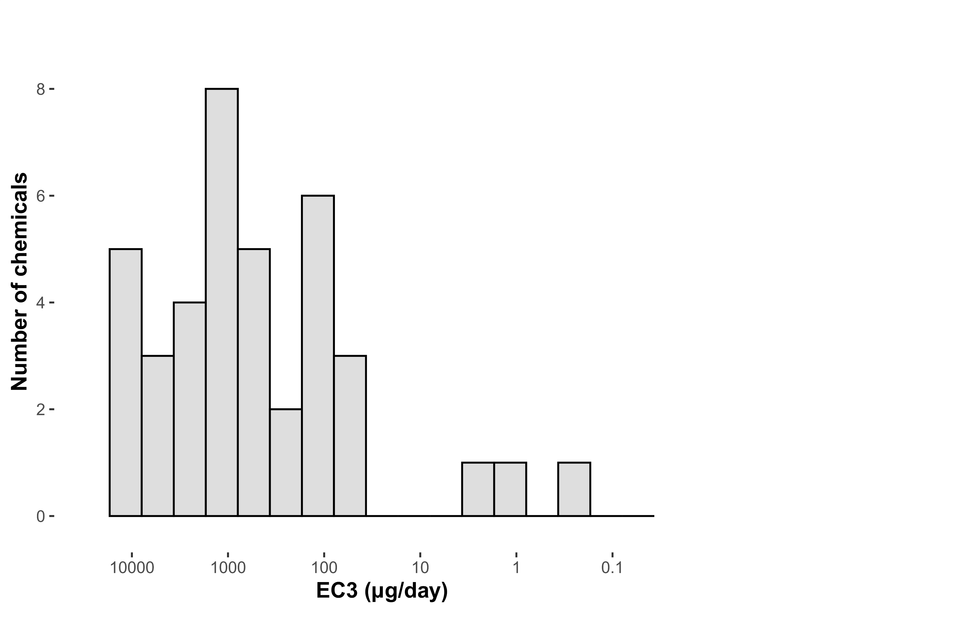
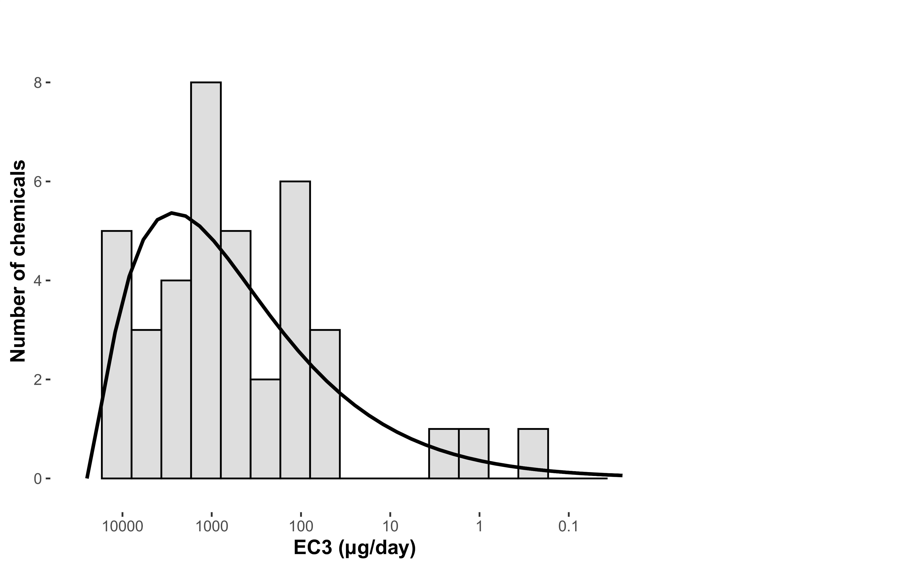
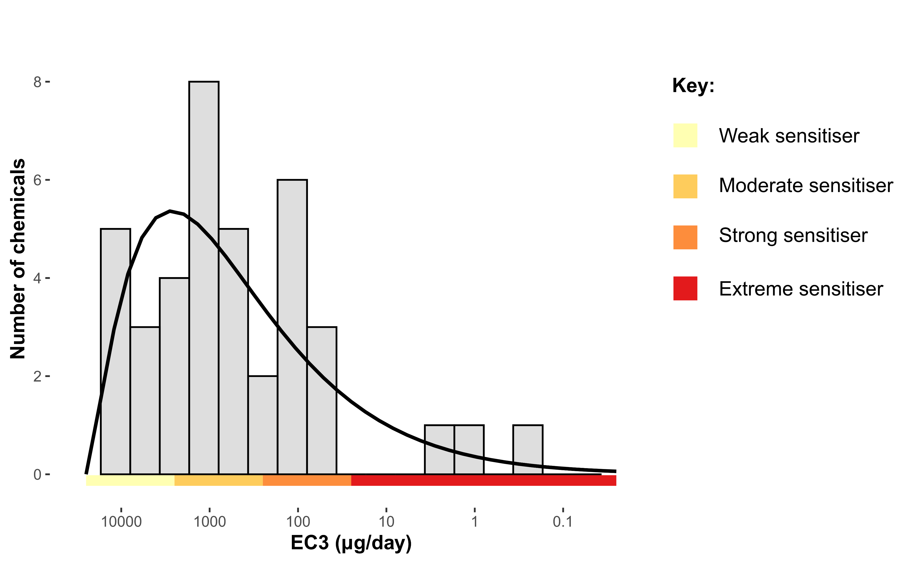
How potent are E&L sensitizers?
39 compounds with dermal potency information
Benzo[a]pyrene
p-Benzoquinone
tert-Butylhydroquinone
Notes:
First question to check is, how potent are these 39 E&Ls according to their EC3 values?
Convert EC3 to µg/day (as previously described) and plot as histogram on logarithmic scale
Overlay gamma distribution to show trend, as done previously in DST work (provide brief context for this)
Overlay potency categories to show to show that as before, most E&Ls in this dataset are weak/moderate
Discuss 3 most potent extreme sensitisers: Benzo[a]pyrene, tert-Butylhydroquinone, p-Benzoquinone – 2 extrapolated from dose-response data, one extrapolated from human threshold

Slide 18
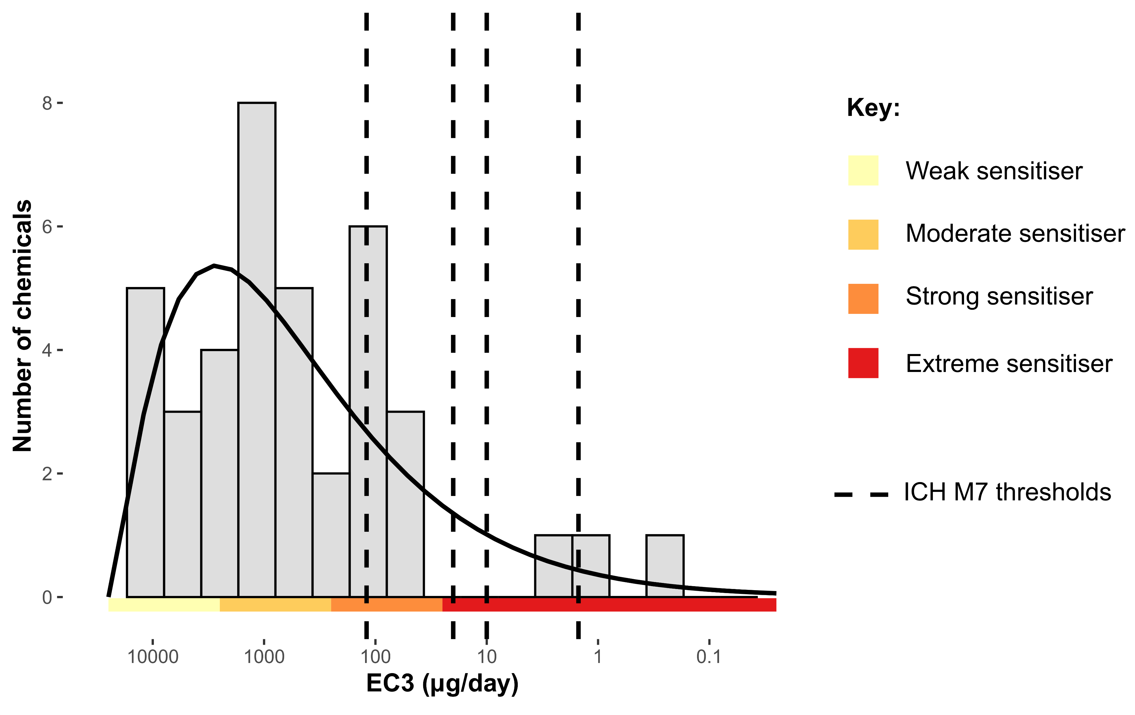
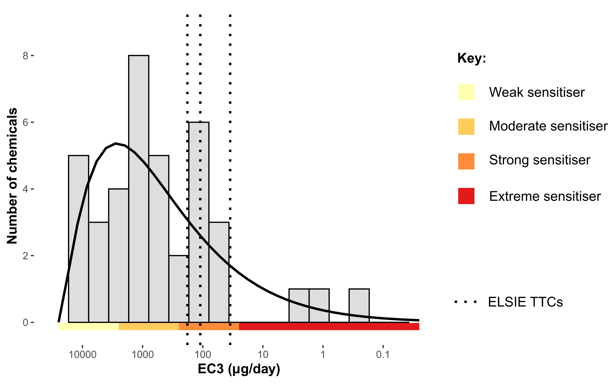
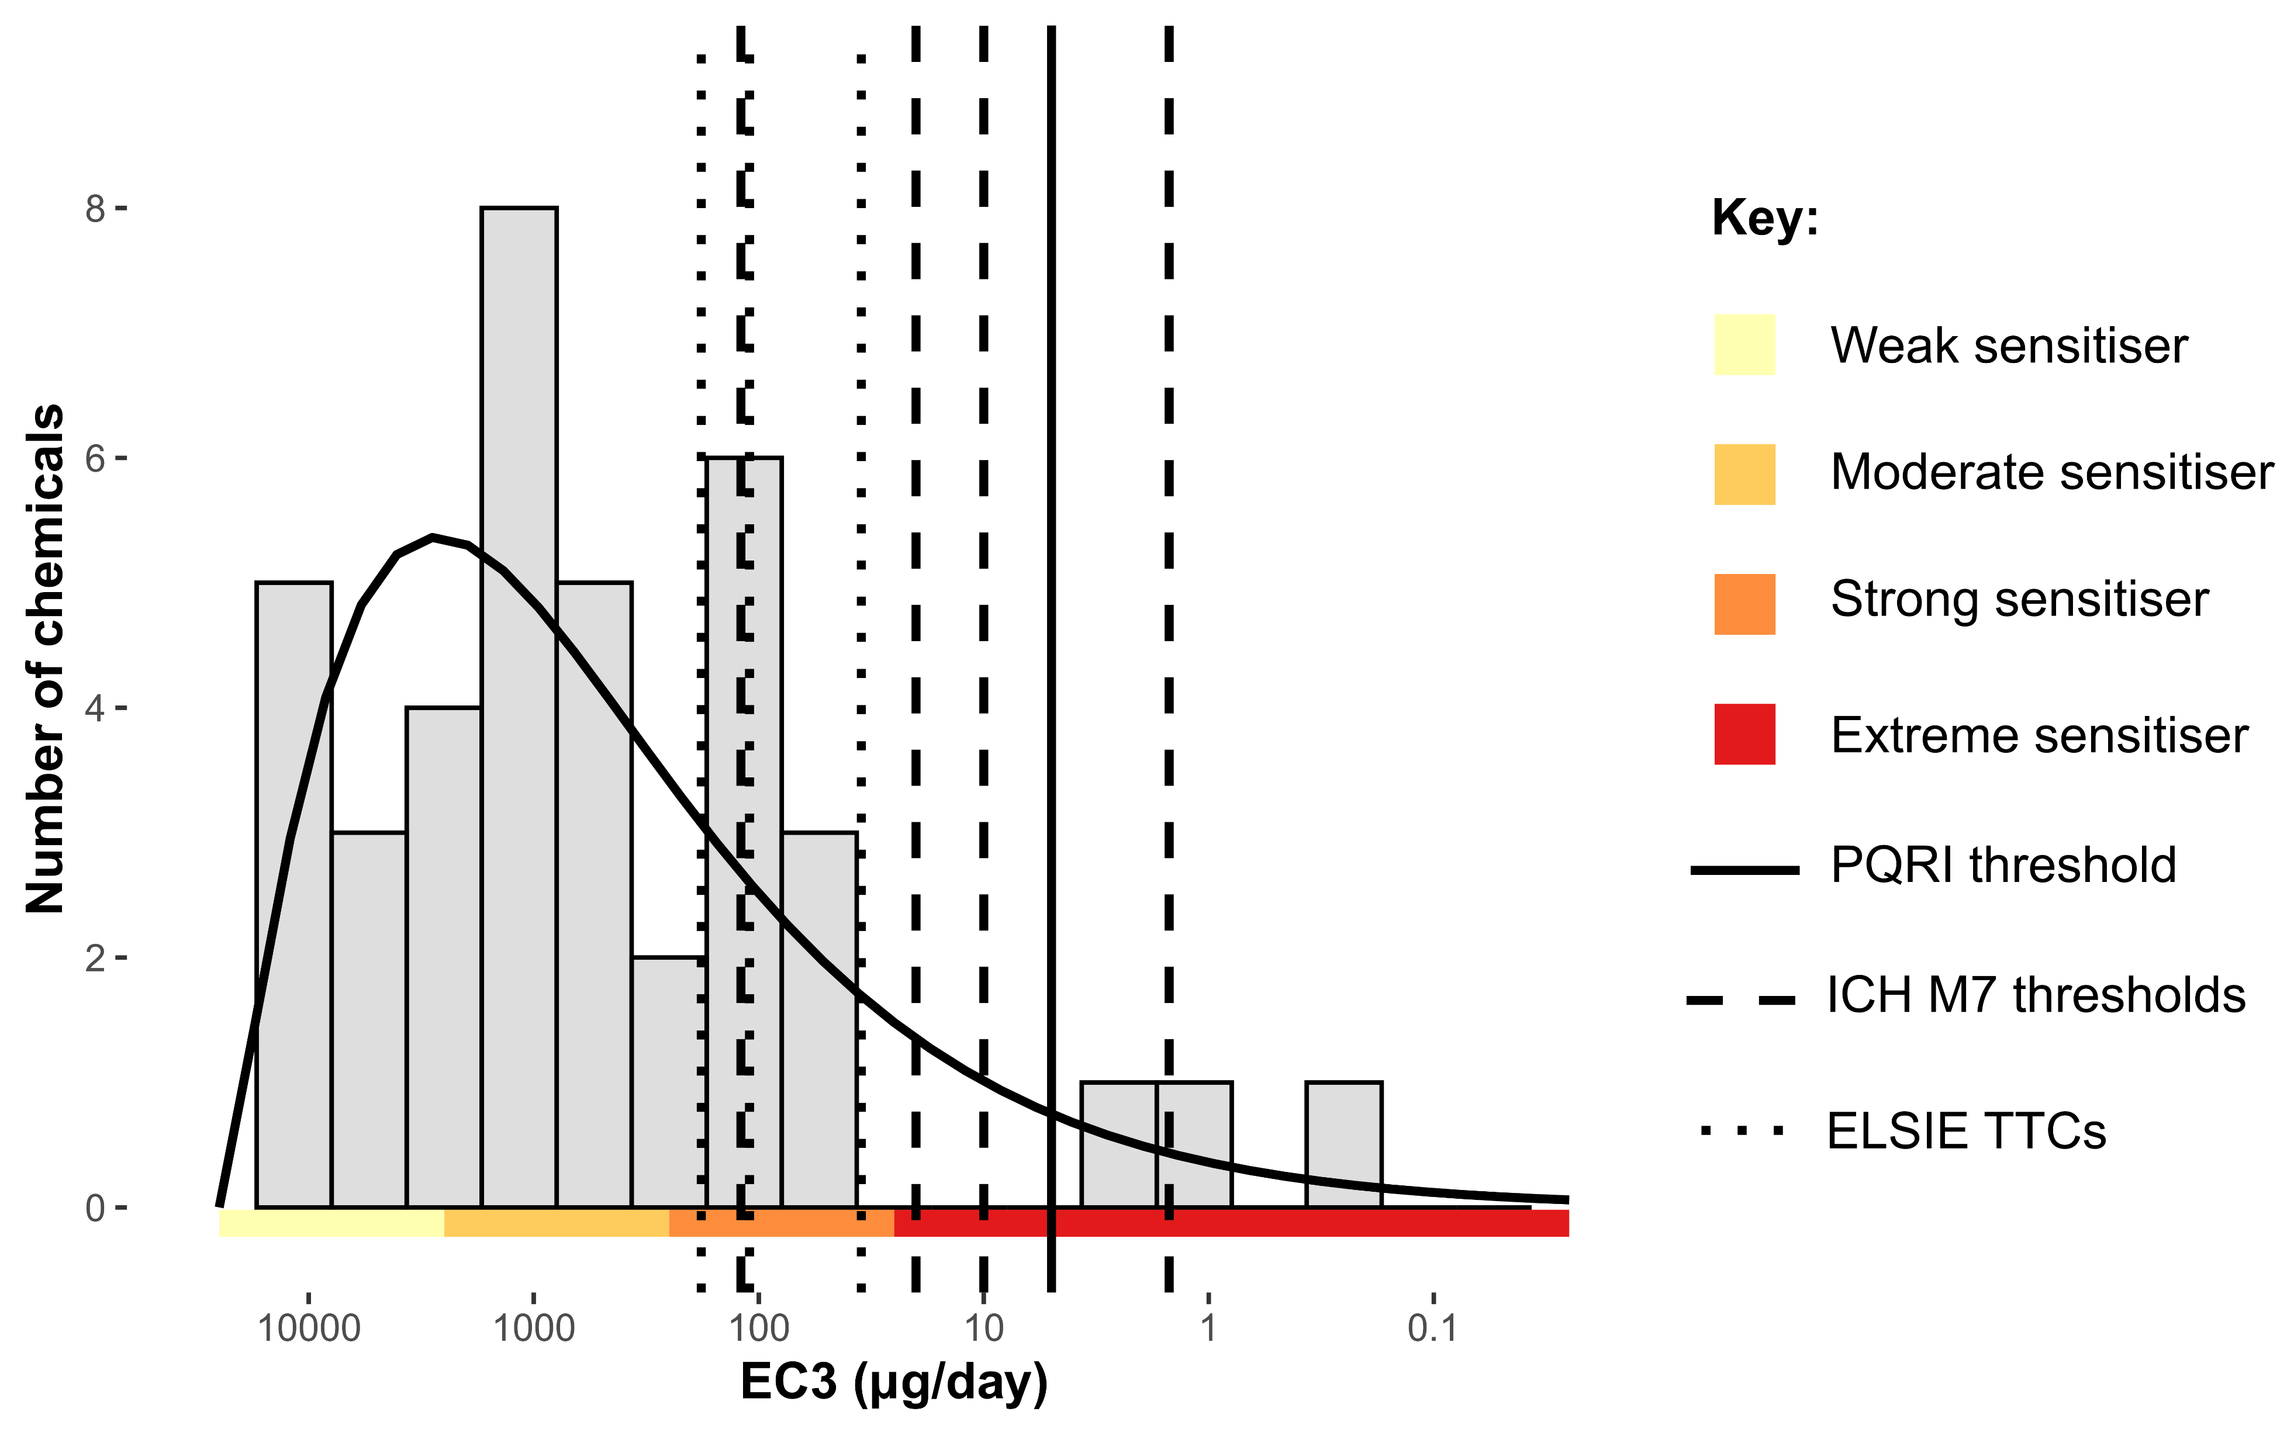
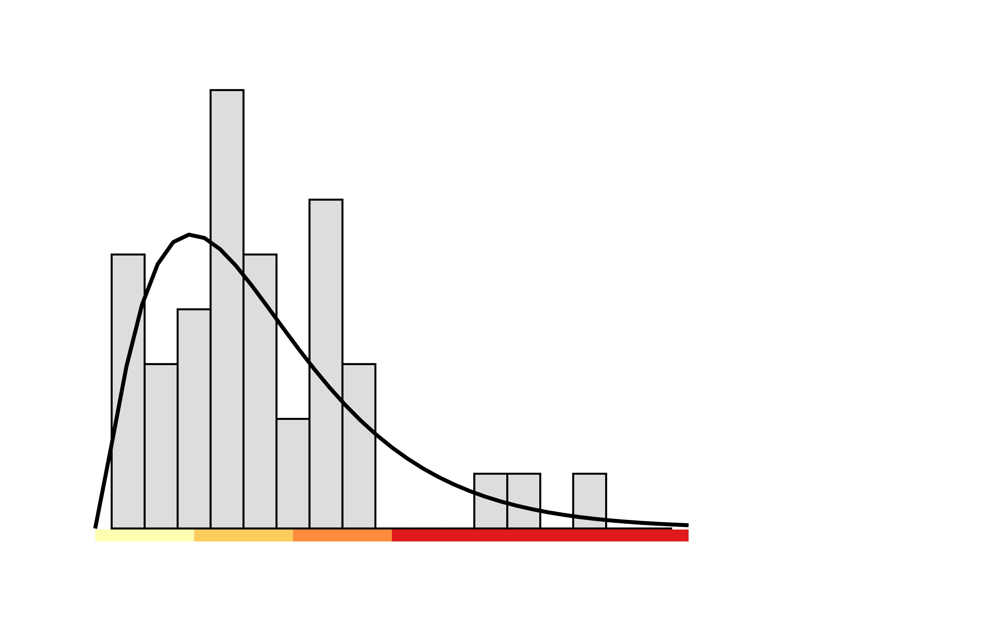
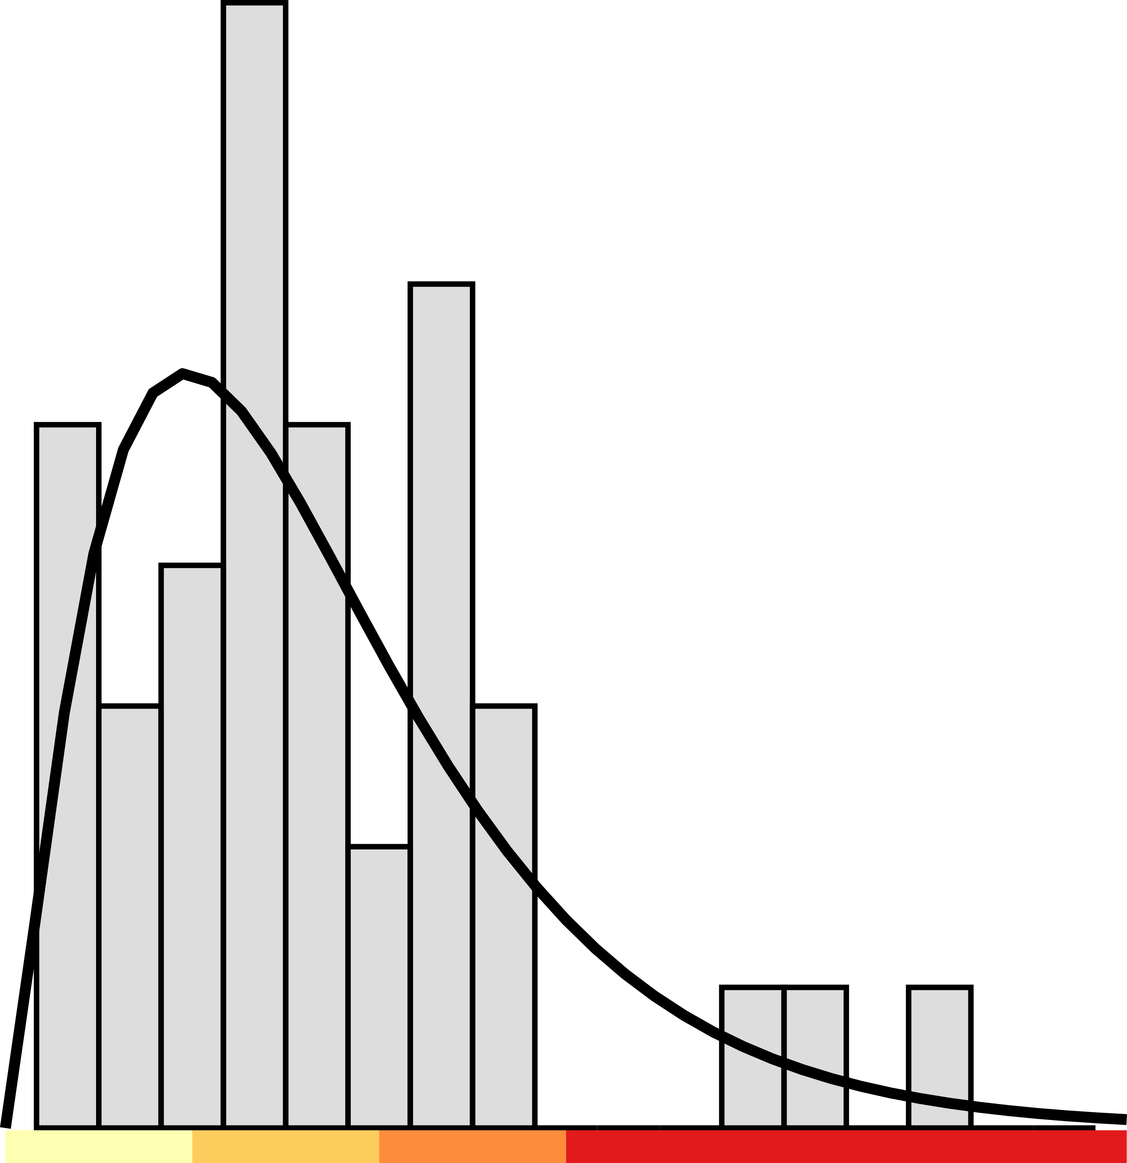
How do existing thresholds compare?
39 compounds with dermal potency information
Notes:
Next question to answer is, how do existing thresholds compare to potency of E&Ls?
As EC3 values have been represented in µg/day, these can now be overlaid directly onto plot
Mutagenic thresholds from ICH M7 first as dashed lines - all weak/moderate sensitisers less potent than even 120 µg/day, only 3 most potent extreme sensitisers more potent than 10 µg/day and also 5 µg/day
Non-mutagenic thresholds from ELSIE second as dotted lines - all weak/moderate sensitisers less potent than all 3 TTCs, only 3 most potent extreme sensitisers more potent than 35 µg/day

Slide 19
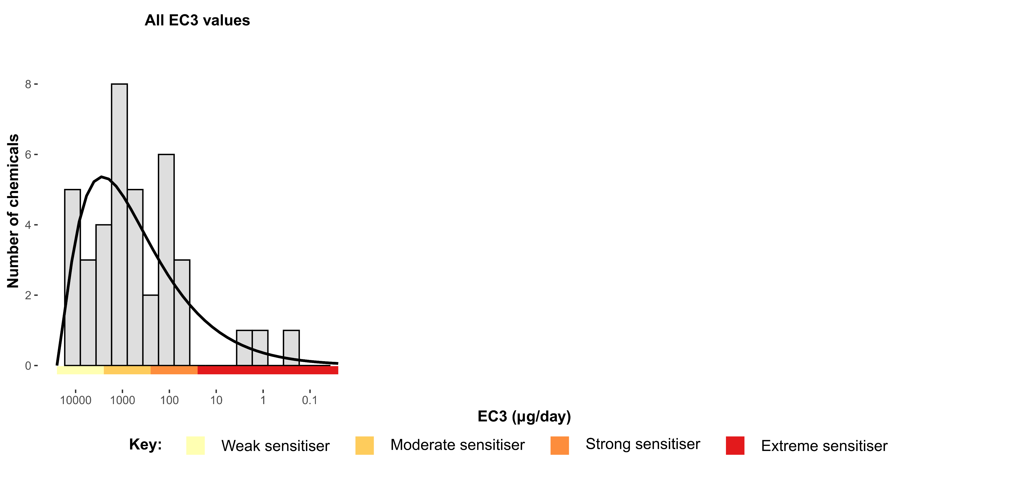
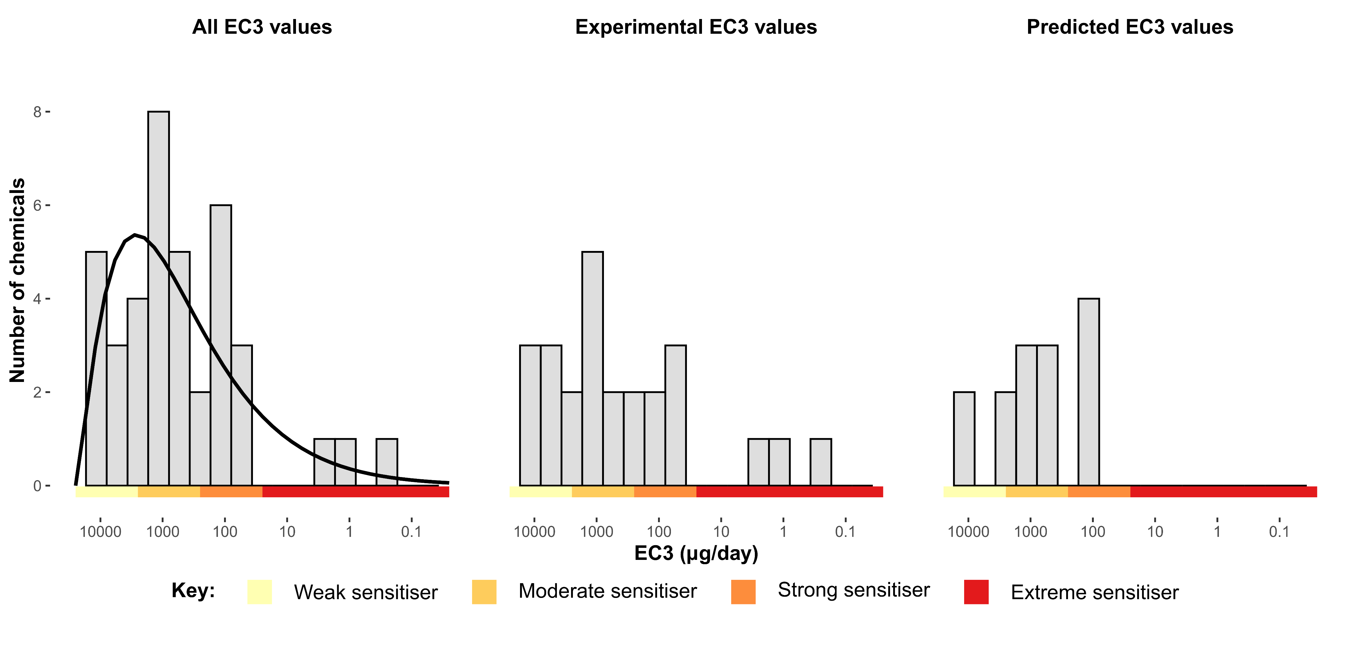
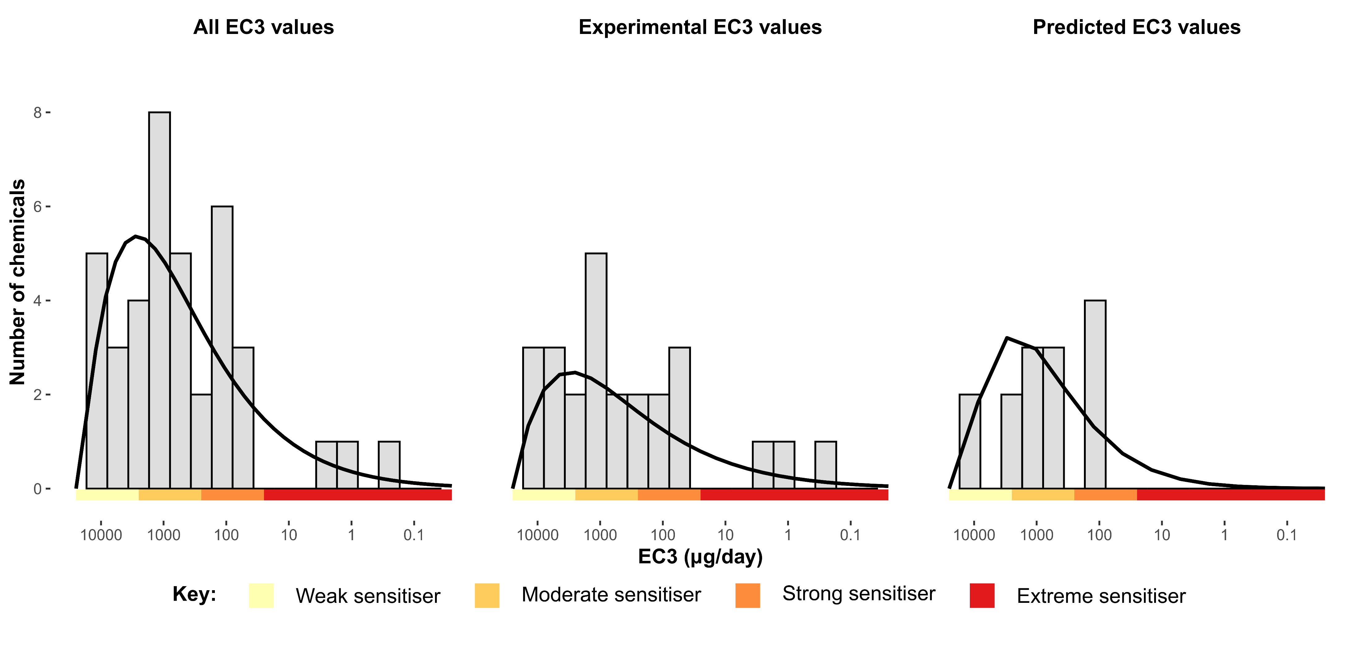
Are predicted EC3 values reliable?
39 compounds with dermal potency information
Notes:
Final question to consider, are predicted EC3 values a reliable indicator of potency in the absence of experimental data?
Split histogram into 2, first showing 25 experimental EC3 values, second showing 14 predicted EC3 values
As before, overlay individual gamma distributions to show trend in potency
In both cases most E&Ls are weak/moderate, and the individual EC3 distributions are similar

Slide 20
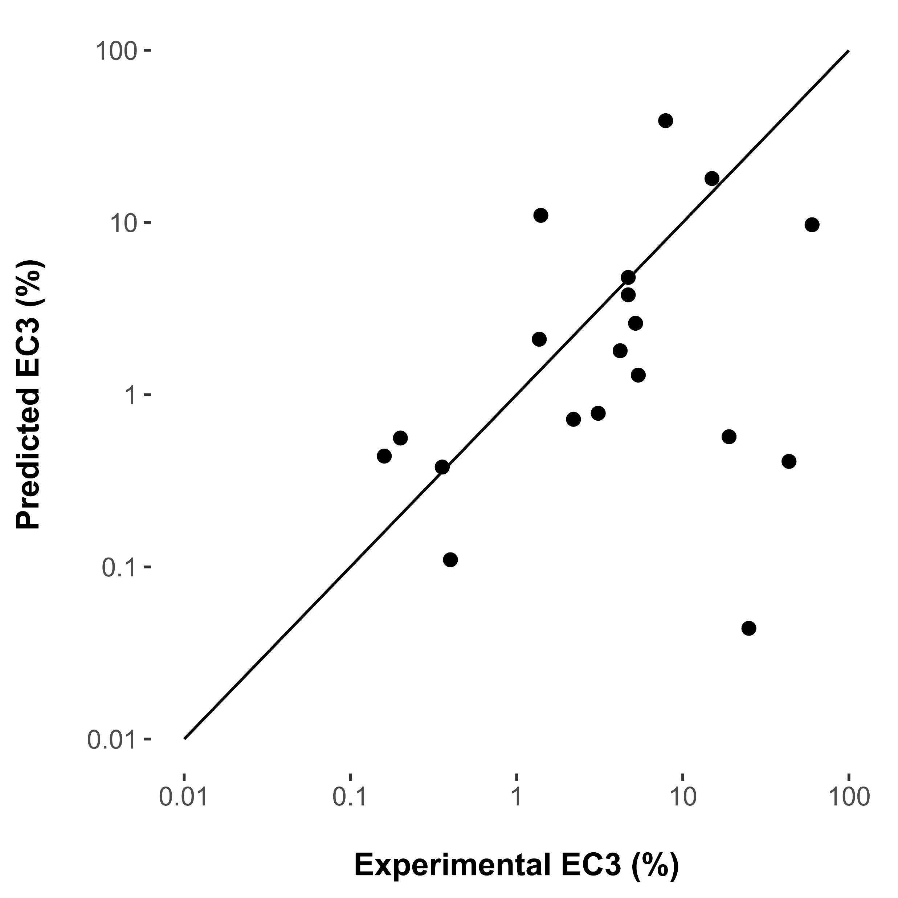
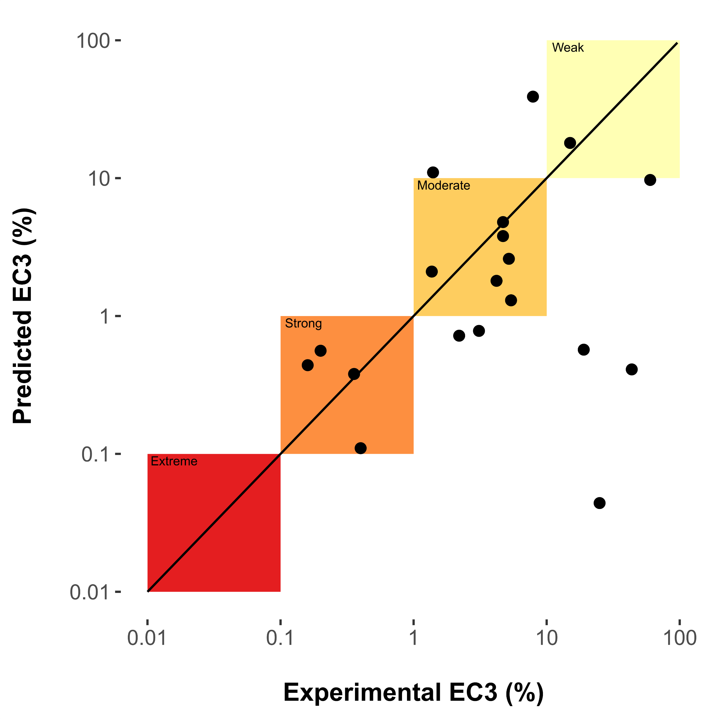
Are predicted EC3 values reliable?
25 compounds with experimental EC3 values
Notes:
As an additional check, focused on 25 compounds with experimental EC3 values
Checked how well Derek would have predicted their potency (in absence on experimental data about them)
Most are predicted within the correct ECETOC potency category
When the model is wrong it is more likely to over- than under-predict (as designed)

Slide 21
Take home messages
Sensitizing E&Ls are mostly weak/moderate
  69% of the dataset analysed has an EC3 value >1%
Existing E&L thresholds are generally protective
  10 µg/day (ICH M7) would be protective 92% of the time
  35 µg/day (ELSIE TTC) would be protective 86% of the time
For potential sensitizers, predicted EC3 values from Derek Nexus are conservative
  89% are in correct ECETOC potency category or more potent
Notes:
Summary of points from previous three slides:
If sensitising, most E&Ls are weak/moderate (confirms previous observation from ELSIE data)
The existing thresholds would generally be protective if used, as most E&Ls are less potent than ICH M7 and parenteral TTCs (except extreme sensitisers)
Also observed that predicted EC3 values are in line with experimental EC3 values, suggesting their usefulness as a potency estimate for E&Ls in the absence of experimental data

Slide 22

Extended E&L
Dataset Analysis
Glenn J. Myatt
Vice President, Informatics
Instem

Slide 23
Objectives
To create a representative database of E&L from the ELSIE and PQRI published datasets
Understand common and unique chemicals and chemicals classes
Identify chemical classes likely to flagged by in silico tools predicting
  DNA-reactive mutagenicity
  Dermal potent (strong or extreme) sensitization

Slide 24
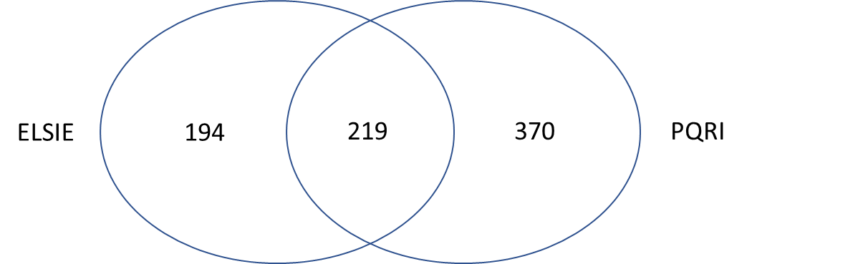
Combined ELSIE and PQRI datasets
Datasets:
    ELSIE¹. 466 compounds compiled based on their being observed in pharmaceutical, biological and device applications and processes
    PQRI². 611 chemical structures includes compounds that have been known to extract or leach from manufacturing equipment and/or container closure components during the manufacture of parenteral drug products.
Processing:
  All chemicals in the datasets were mapped to a unique chemical after being converted to their structure-activity relationship (SAR) forms
      salt forms are neutralized
      complex structures, such as mixtures and polymers, are excluded from the set
Parris, et al., Sensitization Assessment of Extractables and Leachables in Pharmaceuticals: ELSIE Database Analysis (2022); elsiedatabase.org
PQRI 2021. Product Quality Research Institute PQRI, Safety Thresholds and Best Demonstrated Practices for Extractables and Leachables in 2. Parenteral Drug Products (Intravenous, Subcutaneous, and Intramuscular). October 2021

Slide 25
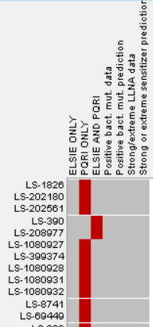
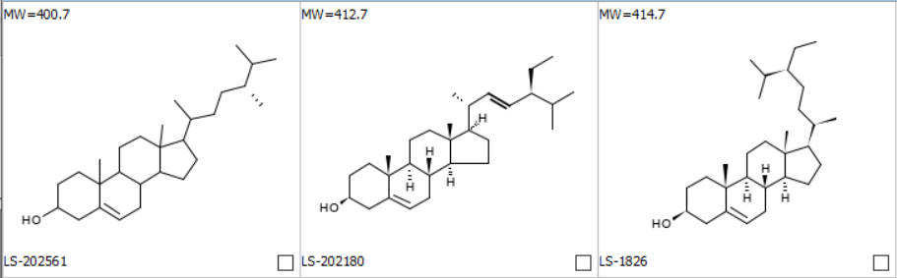
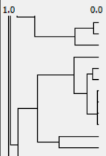
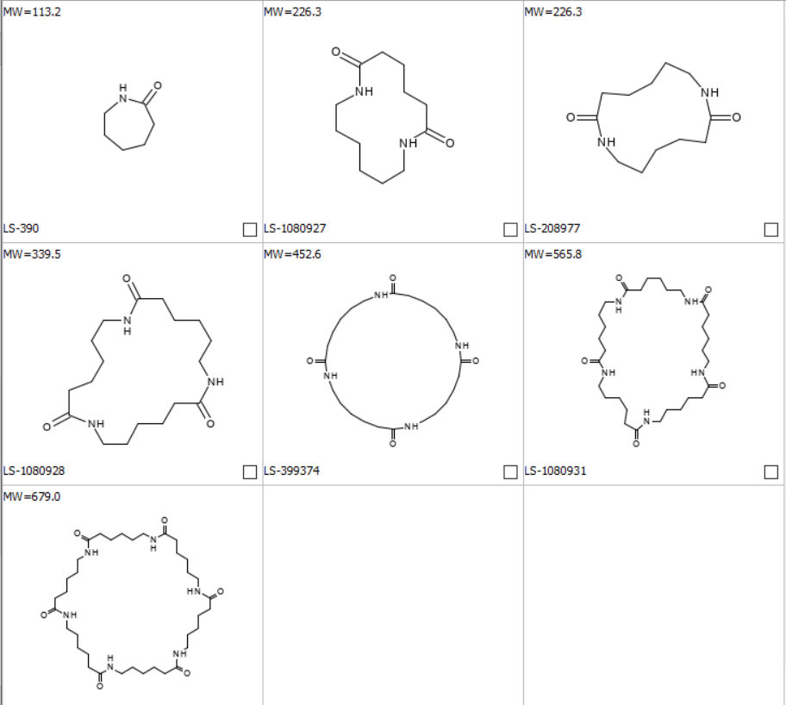
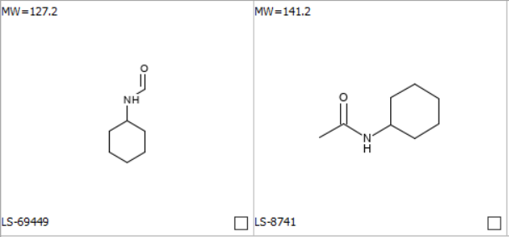
Identifying chemical classes through clustering
149 chemicals classes containing two or more chemicals
  5% (8/149) of classes contained only chemicals from the ELSIE dataset
  19% (29/149) of classes contain only chemicals from the PQRI dataset
  75% (112/149) of classes contained chemicals from both datasets

Slide 26
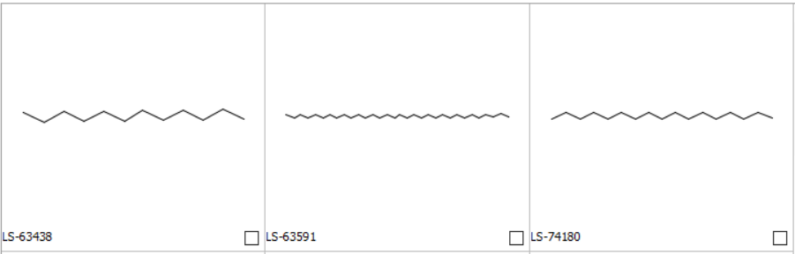
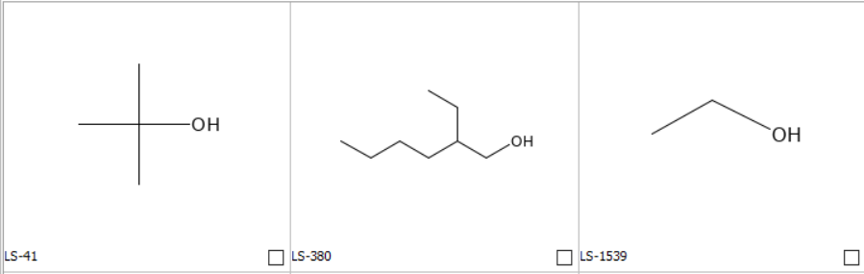
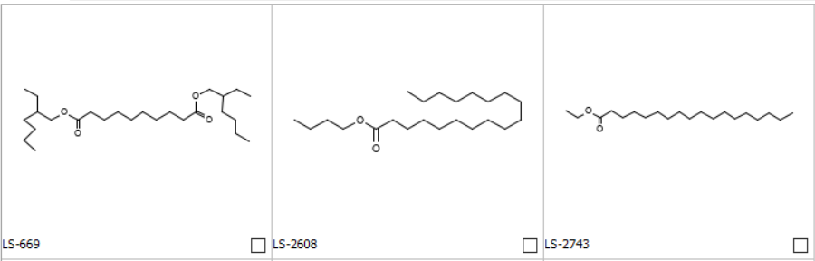
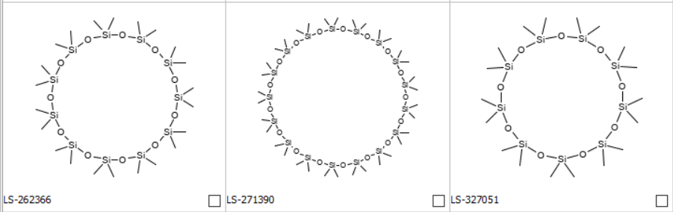
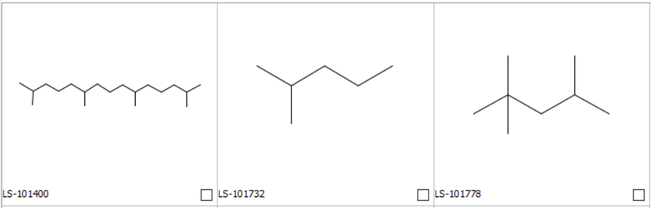
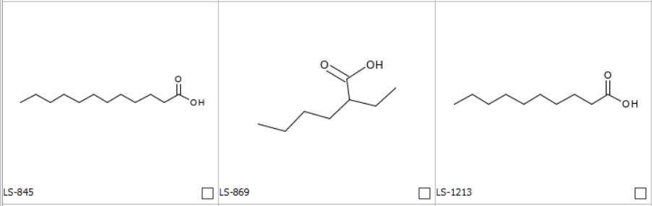
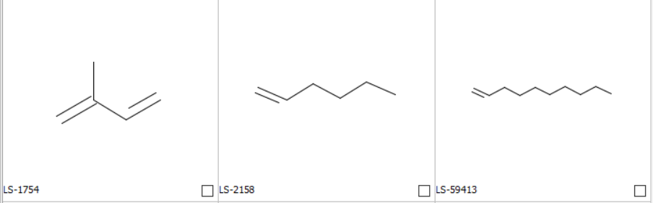
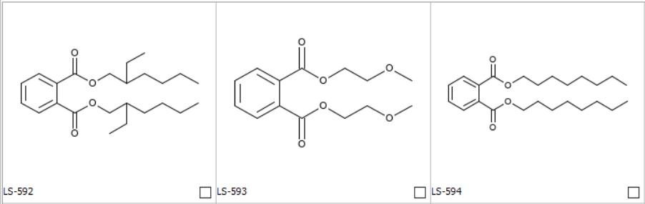
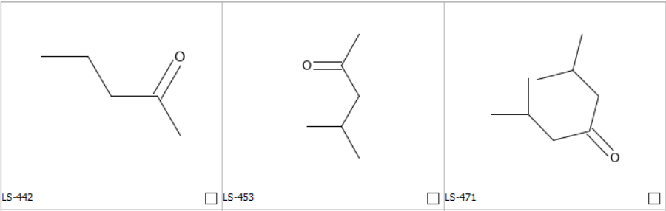
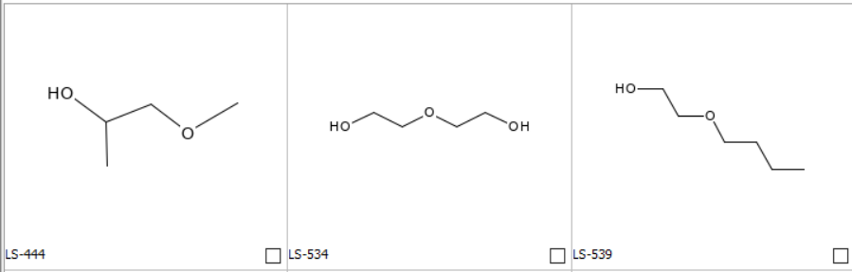
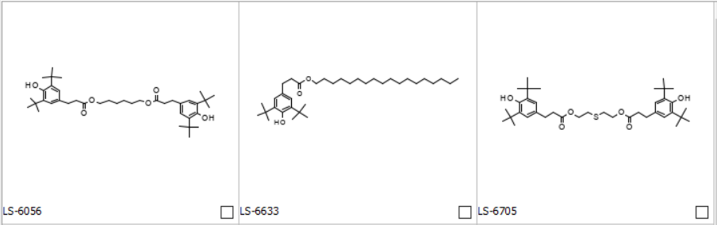
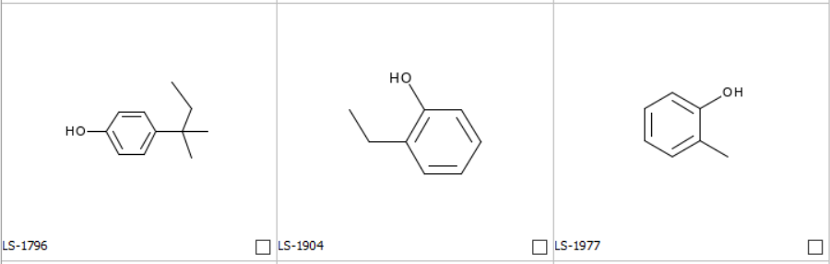
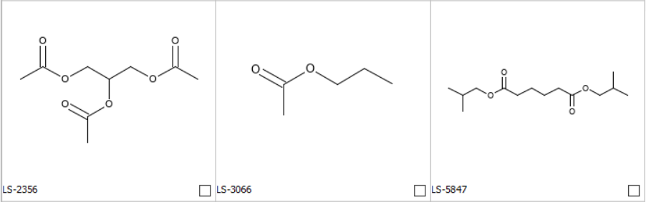
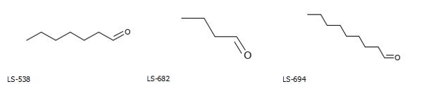
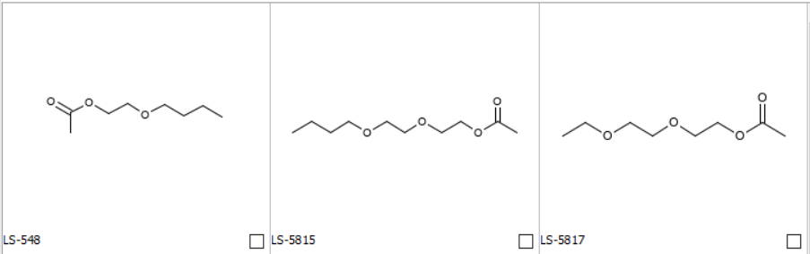
Chemical classes with 10 or more examples
Examples from the ELSIE and PQRI datasets
Examples from only ELSIE
Alkyl cluster (acyclic, linear) (25)
Alkyl alcohol analogs (19)
Di(2-ethylhexyl)sebacate analogs (21)
Large cyclosiloxanes (12)
Alkyl cluster (acyclic, branched) (18)
Butyric acid analogs (19)
Propylene analogs (19)
Dimethyl phthalate analogs (15)
2-pentanone analogs (14)
Butoxyethanol analogs (17)
Methyl 3-(3,5-di-tert-butyl-4-hydroxyphenyl)propionate analogs (13)
p-cresol analogs (10)
Ethyl acetate analogs (13)
Butyraldehyde analogs (10)
2-Butoxyethanol acetate analogs (10)

Slide 27
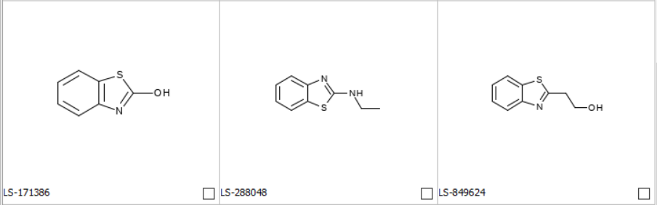
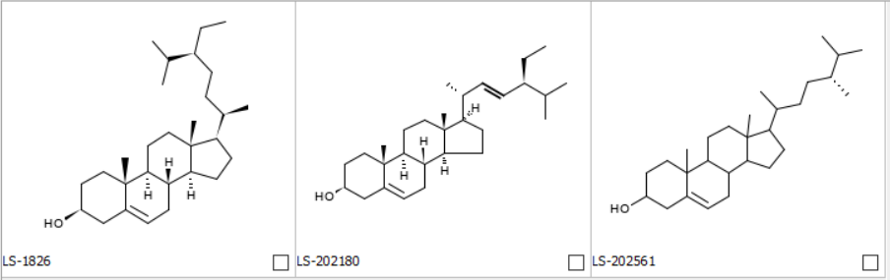
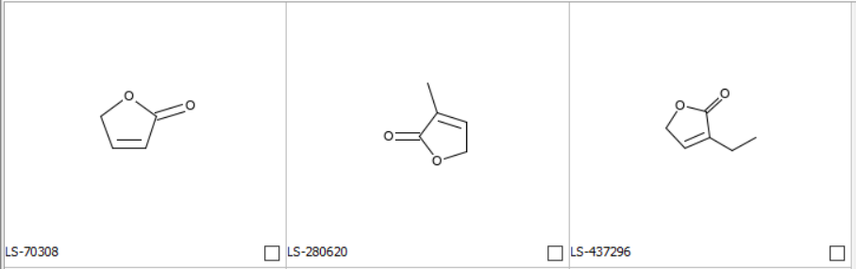
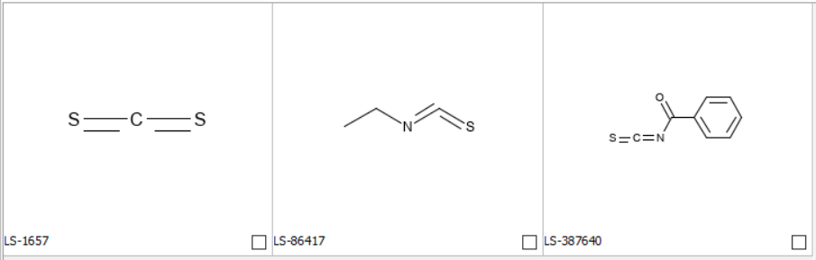
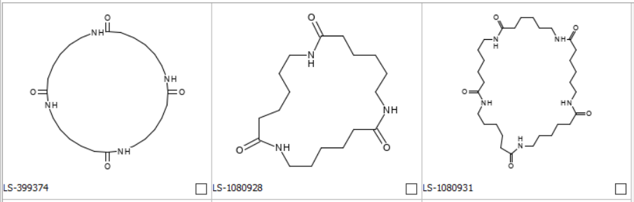
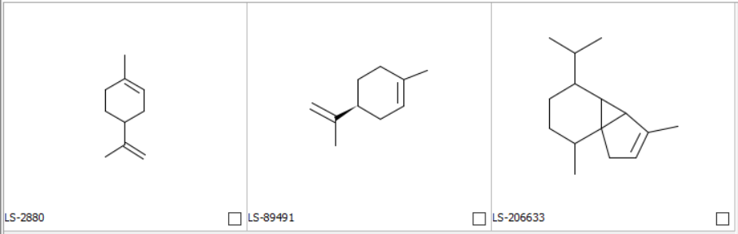
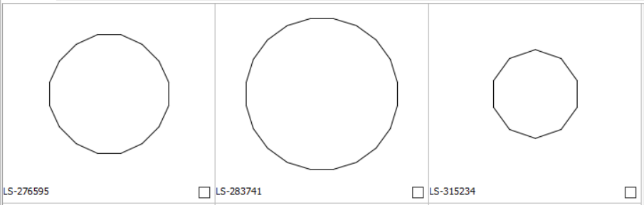
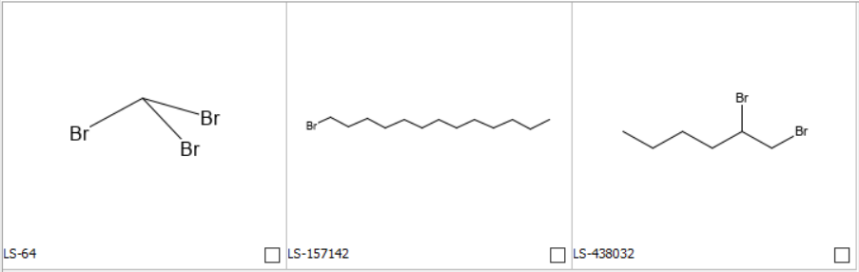
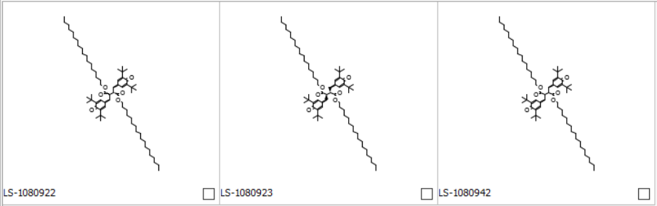
Unique chemical classes to ELSIE and PQRI with >3 structures
Examples from only ELSIE
Examples from only PQRI
Large cyclosiloxanes (12)
Substituted 1,3-benzothiazole (8)
Beta-Sitosterol analogs (3)
Butenolide analogs (4)
Isothiocyanate analogs (3)
Amino(NH)carbonyl, N-(alkyl, cyc)- (4)
dl-limonene analogs (3)
Alkyl cluster (cyclic) (4)
Bromide, alkyl (3)
Unconjugated Bisquinonemethide analogs (3)

Slide 28
In silico predictions
Experimental data identified for the combined dataset
  Bacterial mutagenicity experimental data¹
  Dermal sensitization ECETOC potency categories (strong or extreme)²
In silico model based on two methodologies were used in the absence of experimental data
  DNA-reactive mutagenicity³
  Potent dermal sensitizers (strong or extreme)⁴
Expert review
  Consensus overall calls based on an expert review following standard documented procedures⁵
  This review consisted of an interrogation of model features, an assessment of structurally similar analogs, and a review of reaction mechanisms.
1. Leadscope bacterial mutagenicity reference database that includes ~22,000 chemicals
2. Leadscope LLNA reference databases that includes ~1,500 chemicals
3. Leadscope Bacterial Mutation expert alerts v8 and Leadscope Bacterial Mutation statistical-based QSAR model v2
4. Leadscope LLNA statistical version (v3) and LLNA alerts version (v2)
5. Myatt GJ, et al., (2018) In silico toxicology protocols. Regul Toxicol Pharmacol 96:1–17

Slide 29
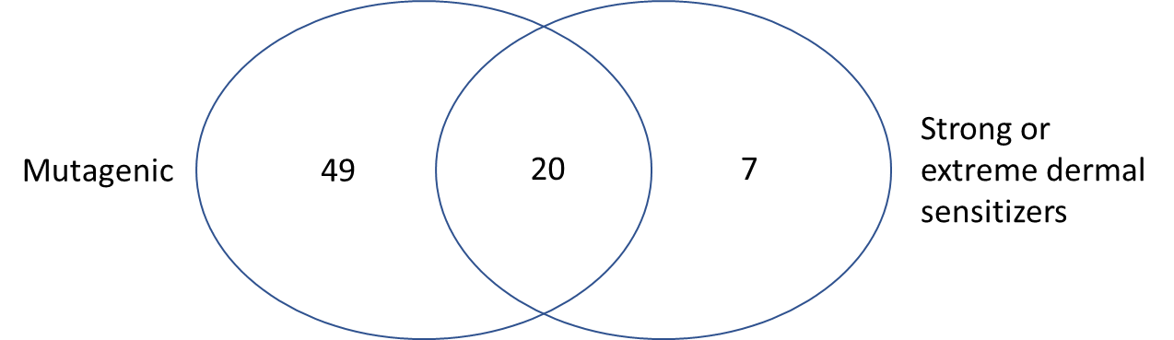
Prevalence of mutagens and potent sensitizers in combined dataset
9% (69/783) of chemicals were flagged as potential mutagens
~4%(27/783) were flagged as potent dermal sensitizers
For chemicals predicted to the potent sensitizers, 74% (20/27) are also predicted to be mutagens

Slide 30
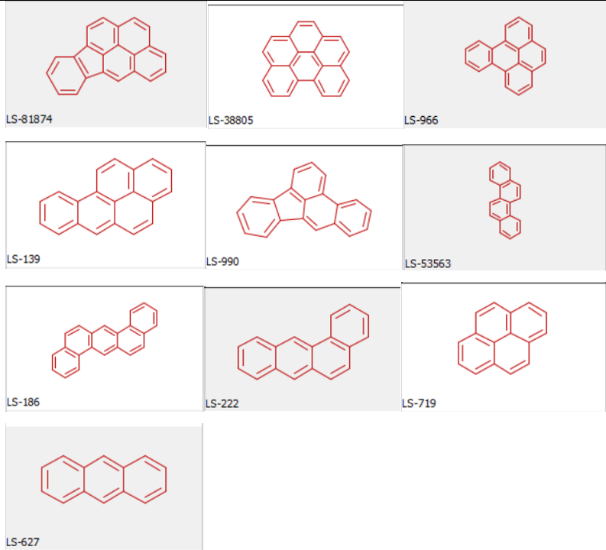
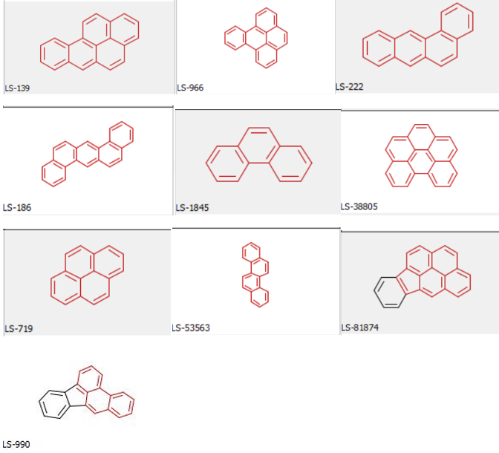
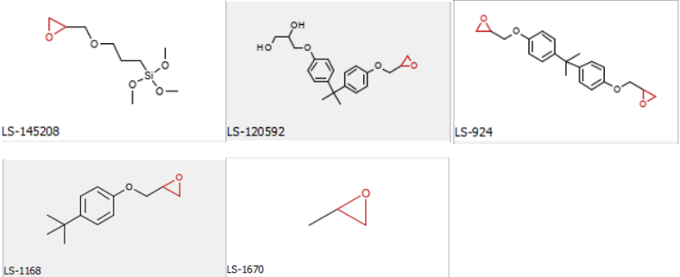
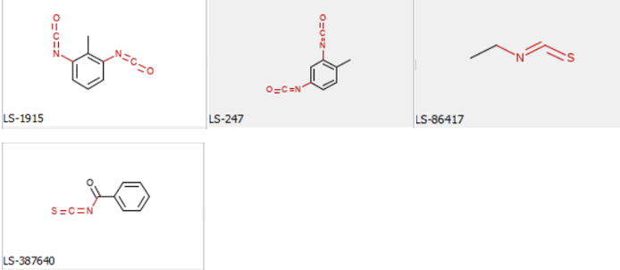


Main alerts fired for bacterial mutagenicity and potent sensitization
Bacterial mutagenicity alerts
Potent sensitization alerts
47: polycyclic aromatic hydrocarbons (10)
53: Polyaromatic hydrocarbon (3)
159: unhindered epoxide (5)
32: Alert:Iso(thio)cyanates (4)
267: aromatic amine(NH2) (strong activating anilines) (4)
13: Aromatic diamino-, dihydroxy-, or amino-hydroxy- compounds (3)

Slide 31
Prediction of DNA-reactive mutagenicity and potent sensitization for unique chemical classes
Examples from only ELSIE
Examples from only PQRI
Large cyclosiloxanes (12)
Substituted 1,3-benzothiazole (8)
Beta-Sitosterol analogs (3)
1 flagged as mutagen, unrelated to the chemical class
1 flagged as a potential mutagen, 2 flagged as potential potent dermal sensitizer
Butenolide analogs (4)
Isothiocyanate analogs (3)
Amino(NH)carbonyl, N-(alkyl, cyc)- (4)
dl-limonene analogs (3)
2 out of the 3 chemicals were flagged as potential mutagens; however, acceptable limits may be derived for this class
Alkyl cluster (cyclic) (4)
Bromide, alkyl (3)
Unconjugated Bisquinonemethide analogs (3)

Slide 32
Conclusions
Combining ELSIE and PQRI dataset created a large and representative dataset of 783 E&Ls
    219 chemicals in both ELSIE and PQRI datasets
    75% of the chemical classes included examples from both the ELSIE and PQRI
    Unique classes included:
        Large cyclosiloxanes (only in the ELSIE dataset)
        Isothiocyanates (only in the PQRI dataset)
In silico analysis
    9% (69/783) of chemicals were flagged as potential mutagens
    ~4% (27/783) were flagged as potent dermal sensitizers
        74% (20/27) potent dermal sensitizer predicted as mutagens
            7 predicted potent dermal sensitizers not predicted as mutagens
      Only two classes (≥3 examples) unique to PQRI had multiple chemicals that flagged for mutagenicity and/or potent dermal sensitization
      Analysis supports Parris et al., 2022 finding of low prevalence for potent dermal sensitizers in the E&L chemical space
Parris et al., Sensitization Assessment of Extractables and Leachables in Pharmaceuticals: ELSIE Database Analysis (2022

Slide 33
Panel Discussion

Slide 34


Panel Discussion
Patricia Parris
Global Risk Assessment Services Toxicologist
Pfizer, Inc.
Geraldine Whelan
Computational Toxicologist
GSK
Martyn Chilton
Principal Scientist
Lhasa Limited
Jessica Whritenour
Regulatory Toxicology Lead
Pfizer, Inc.
Moderator
Glenn J. Myatt
Vice President, Informatics
Instem
Bruce Naumann
Toxicologist
Retired Merck/MSD

Slide 35
Topics for Discussion
Considering the importance of assessment of skin sensitization potency, and the low expected levels of that may appear in drug products, when do the results of in silico analysis and in vitro/in vivo studies clearly show skin sensitization is not a significant concern and other toxicological endpoints should be used to determine if levels of extractables and leachable are acceptable?
ICH Q3E
For parenteral products with less than lifetime treatment duration what AET/SCT is ELSIE proposing to use?
If a skin sensitizer is identified as a potential leachable above the AET/SCT how do you conduct a toxicological assessment if there is no in vivo sensitization studies available?
Future work – Case studies

Slide 36
Thank you!!

