Slide 1
Development of Duration-Based Non-Mutagenic Thresholds of Toxicological Concern (TTC) Relevant to Parenteral Extractables and Leachables (E&Ls)
Melisa Masuda-Herrera
Gilead Sciences, Inc.
ELSIE Webinar
September 13, 2022

Slide 2




Pharmaceutical Components
Polymeric components used in the manufacture, storage, and use of pharmaceuticals can potentially release chemicals into the drug product that might present a safety risk to patients
Tubing
Storage Bags
Filters
Container Closure System

Slide 3
Extractable vs. Leachable
Extractable
Components
Could be released
Extraction solvent
Aggressive (stressed) conditions
Leachable
Drug product
Do migrate
Drug product formulation
Normal conditions
Extractables
Leachables
Leachables are often a subset of Extractables… but not always!

Slide 4

Extractables and Leachables Safety Information Exchange (ELSIE) Consortium
Established in 2007
30+ companies spanning biotechnology, pharmaceutical, and medical device industries
Developed white papers to describe E&L evaluation within a risk management framework

Slide 5
ELSIE Risk Management Framework
Extractables & Leachables Safety Information Exchange (https://www.elsiedata.org/elconcepts), 2020

Slide 6
Risk Control – Safety Assessment
Review of available literature and/or computational toxicology assessment to derive substance-specific acceptable exposures
  Broschard et al. (2016) and Parris et al. (2020)
In the absence of sufficient data, Threshold of Toxicological Concern (TTC) concepts can be used to define acceptable exposures posing negligible risk to patients

Slide 7
Threshold of Toxicological Concern (TTC)
Dose that is not likely to result in an adverse effect in the exposed population
Provide safe exposure levels for chemical substances lacking chemical specific toxicology data
Examples:
  TTC for Mutagenic Impurities (ICH M7 2018)
  TTC for Non-Mutagenic Impurities (Munro et al. 1996)

Slide 8
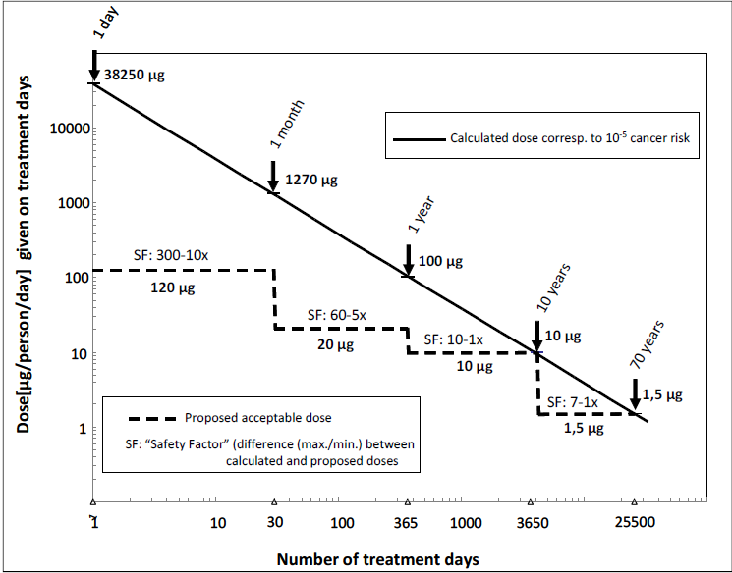
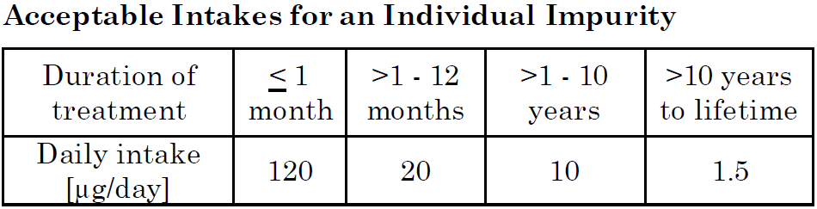
TTC for Mutagenic Impurities (ICH M7 2018)
Mutagenic impurities, with unknown carcinogenic potential
  Cohort of Concern excluded
Less than Lifetime concept

Slide 9
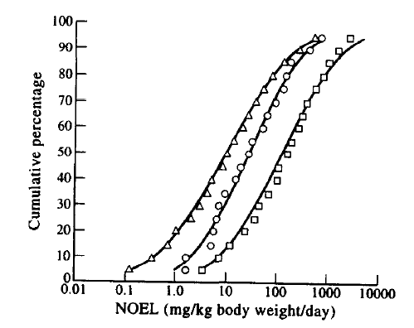
TTC for Non-Mutagenic Impurities (Munro et al. 1996)
Industrial chemicals, pharmaceuticals, food substances, and environmental, agricultural and consumer chemicals
Compounds classified to Cramer Class I, II, III relating structure to toxicity
 | Cramer Class I (137 compounds) | Cramer Class II (28 compounds) | Cramer Class III (448 compounds)
5th Percentile NOEL [mg/kg bw/day] | 3.0 | 0.91 | 0.15
TTC [µg/day]ª | 1800 | 540 | 90
a) 5th Percentile NOEL x 60 kg / 100

Slide 10
TTC for Non-Mutagenic Parenteral E&Ls (ELSIE)
Goal: Derive scientifically justified parenteral TTC for non-mutagenic E&Ls
Make use of the ELSIE database (relevant chemical space)
Consider (experimental or calculated) bioavailability (parenteral route consideration)
Account for different durations of exposure (Less Than Lifetime, intermittent exposures)
Publish all data and calculations (transparency)

Slide 11
Focusing ELSIE Database to TTC Dataset
All E&Ls in ELSIE Database
(488 compounds)
All E&Ls in database at the time of analysis
Non-mutagenic E&Ls
(459 compounds)
Removed mutagens and carcinogens
Non-mutagenic E&Ls with valid NOAELs/LOAELs
(252 compounds)
Removed compounds with inadequate tox data

Slide 12
Steps to Derive Duration-Based TTC
Select Point of Departure (POD)
LOAEL to NOAEL Adjustment
Bioavailability Adjustment
Duration Adjustment
TTC

Slide 13
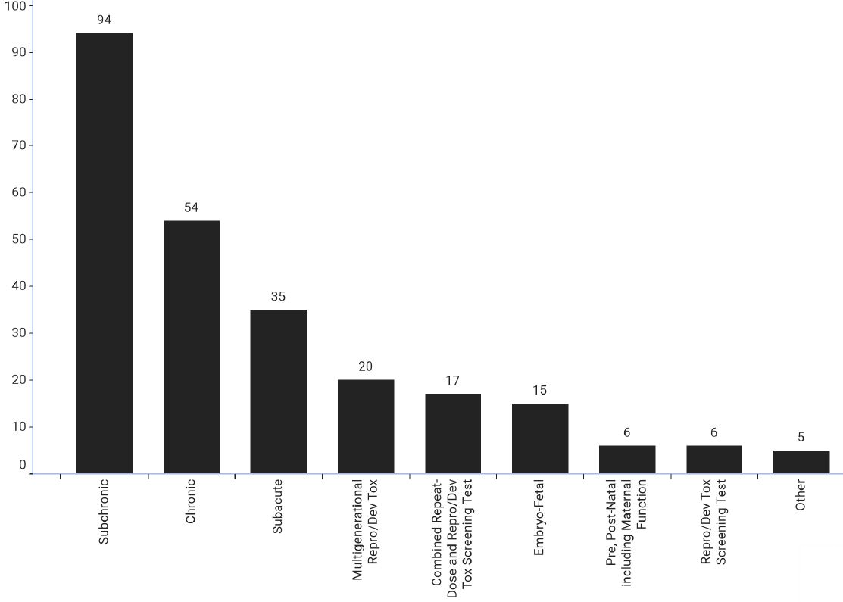
Studies Selected for Point of Departure (POD)
Study Type
Select Point of Departure (POD)
LOAEL to NOAEL Adjustment
Bioavailability Adjustment
Duration Adjustment
TTC

Slide 14
LOAEL to NOAEL Adjustment
Based on ICH Q3C
1 = NOAEL
3 = Non-severe effects
10 = Severe effects (e.g. non-genotoxic carcinogenicity, neurotoxicity or teratogenicity)
Select Point of Departure (POD)
LOAEL to NOAEL Adjustment
Bioavailability Adjustment
Duration Adjustment
TTC

Slide 15
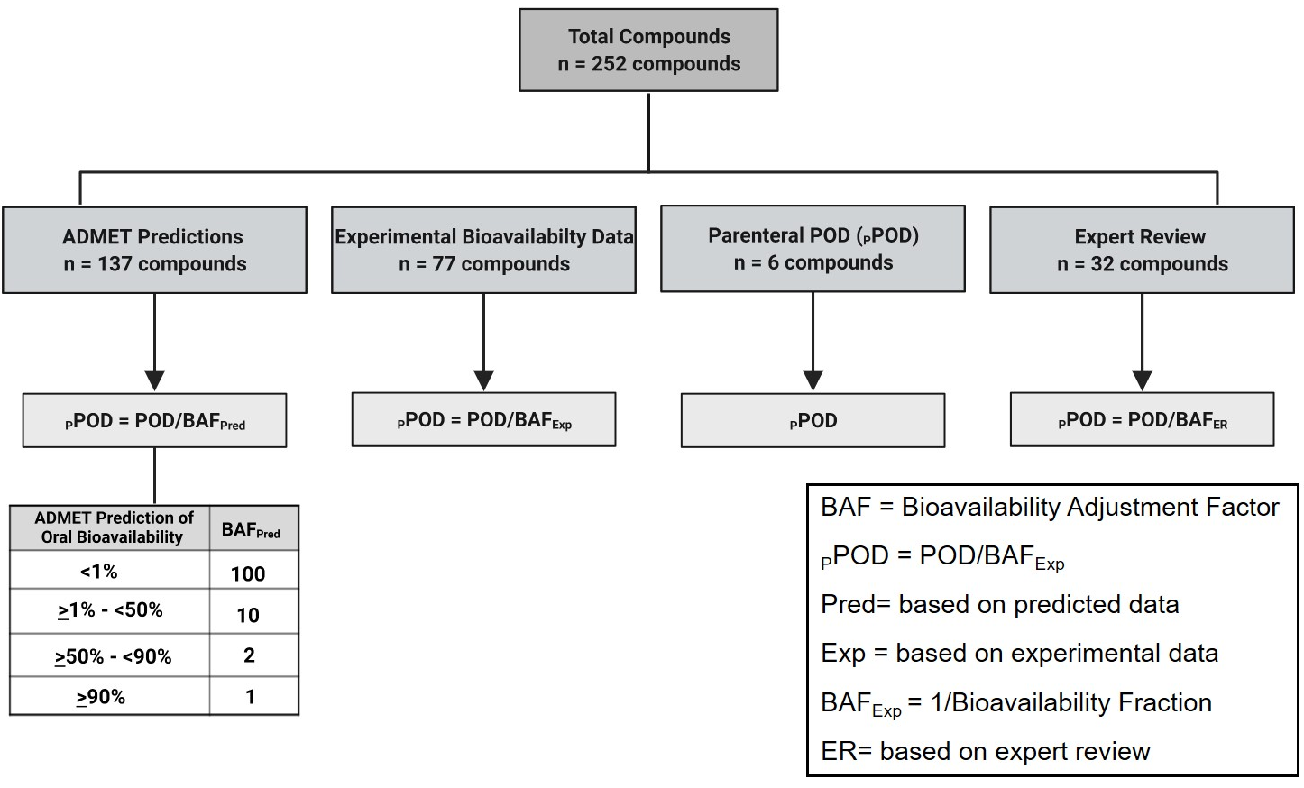

Bioavailability Adjustment
Select Point of Departure (POD)
LOAEL to NOAEL Adjustment
Bioavailability Adjustment
Duration Adjustment
TTC
Based on ICH Q3D

Slide 16
Duration Adjustment
Patient Duration of Exposure
Study Type | ≤ 1 year | >1-10 years | >10 years
Chronic (≥180 days rodent, ≥270 days non-rodent) | 1 | 1 | 1
Subchronic (>30 - <180 days rodent, <270 days non-rodent) | 1 | 1 | 5
Subacute (>3 - 30 days in rodents) | 1 | 5 | 10
Combined repeat dose tox + repro screening (OECD 422) | 1 | 5 | 10
Reproductive toxicity | 1 | 1ª or 5^{b} | 1ª or 10^{b}
Embryo-fetal toxicity | 1 | 1^{c} or 5^{d} | 1^{c} or 10^{d}
Select Point of Departure (POD)
LOAEL to NOAEL Adjustment
Bioavailability Adjustment
Duration Adjustment
TTC
= more than one generation or reprotox is POD
= one generation exposed and parental tox is POD
= fetal tox is POD
= parental tox is POD

Slide 17
Duration Based TTCs
 | ≤1 year | ≤10 years | >10 years to lifetime
Approximate % of Lifetime | ≤1 | >1-15 | >15-100
pPOD at 5th Percentile [mg/kg bw/day] | 0.36 | 0.22 | 0.07
Parenteral TTC [µg/day]ª | 180 | 110 | 35
Select Point of Departure (POD)
LOAEL to NOAEL Adjustment
Bioavailability Adjustment
Duration Adjustment
TTC
a) pPOD x 50 kg / 100

Slide 18
Chemical Space Analysis
Physicochemical property space of all ELSIE database compounds was compared to 3007 public compounds with in vivo data (VITIC and Leadscope databases)
ELSIE compounds are well covered by the space of compounds with known toxicity

Slide 19
Lower 5th Percentile Comparison
Lower 5th Percentile | Route | Compound Type | Number of Compounds | Database | Reference
0.07 mg/kg/day | Parenteral | Extractables / leachables | 252 | ELSIE | Masuda-Herrera 2022
0.15 mg/kg/day | Oral | Pharmaceuticals, food substances, chemicals | 448 (Cramer Class III) | NTP, JECFA IRIS, DART | Munro 1996
0.2 mg/kg/day | Oral | Pharmaceuticals, food substances, chemicals | 613 | NTP, JECFA IRIS, DART | Munro 1996
0.4 mg/kg/day | Oral | Environmentally relevant chemicals | 700 (Cramer Class III) | EPA Toxicity Values | Nelms 2019

Slide 20
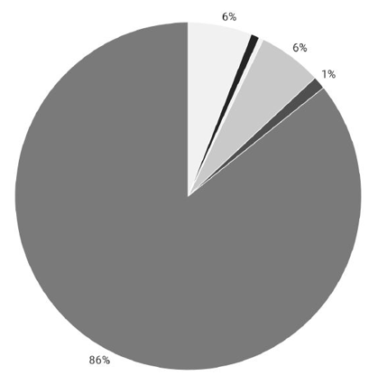
Nonclinical Species and Human Variability Factor
dog
human
monkey
Human variability – 10X factor
Nonclinical species – 10X factor
  For TTC approach, default 10X factor
  Compared to ICH Q3C approach for species specific modifying factor, 94% would use a factor < 10
mouse
rabbit
rat

Slide 21
E&L TTC as Part of Risk Assessment
Identify Extractable/Leachable above AET
Patient Exposure
≤ Threshold for Mutagens? (ICH M7)
Yes
No Safety Alert
Convert Concentration to Patient Exposure (µg/day)
No
Evaluate Mutagenicity based on data or QSAR
Yes
Patient exposure
≤ specific or generic threshold ?
Evaluate toxicological profile based on experimental data
Compound considered mutagenic ?
Decrease compound level or replace material
No
Yes
Compound specific threshold (PDE) ?
No
Yes
No
Apply ELSIE E&L TTC
35/110/180 µg/day

Slide 22
E&L TTC as Part of Risk Assessment
Identify Extractable/Leachable above AET
Patient Exposure
≤ Threshold for Mutagens? (ICH M7)
Yes
No Safety Alert
Convert Concentration to Patient Exposure (µg/day)
No
Evaluate Mutagenicity based on data or QSAR

Slide 23
E&L TTC as Part of Risk Assessment
Identify Extractable/Leachable above AET
Patient Exposure
≤ Threshold for Mutagens? (ICH M7)
No Safety Alert
Yes
No Safety Alert
Convert Concentration to Patient Exposure (µg/day)
No
Evaluate Mutagenicity based on data or QSAR
Yes
Patient exposure
≤ specific or generic threshold ?
Evaluate toxicological profile based on experimental data
Compound considered mutagenic ?
Decrease compound level or replace material
No
Yes
No

Slide 24
E&L TTC as Part of Risk Assessment
Identify Extractable/Leachable above AET
Patient Exposure
≤ Threshold for Mutagens? (ICH M7)
No Safety Alert
Yes
No Safety Alert
Convert Concentration to Patient Exposure (µg/day)
No
Evaluate Mutagenicity based on data or QSAR
Yes
Patient exposure
≤ specific or generic threshold ?
Evaluate toxicological profile based on experimental data
Compound considered mutagenic ?
Decrease compound level or replace material
No
Yes
Compound specific threshold (PDE) ?
No
Yes
No
Apply ELSIE E&L TTC
35/110/180 µg/day

Slide 25
Summary & Conclusion
The TTC concept can be applied for compounds lacking relevant toxicology data
Use of the ELSIE database leverages the relevant chemical space and allows for direct applicability to E&Ls
Consideration of experimental or calculated bioavailability data allows for parenteral route consideration
Application duration-based adjustment factors allow for derivation of TTCs for various exposure durations relevant to E&Ls in pharmaceuticals
A TTC of 35 µg/day is proposed non-mutagenic E&Ls exposures of >10 years to lifetime
TTCs of 110 µg/day (>1- ≤ 10 years) and 180 µg/day (≤1 year) are proposed for shorter exposure durations

Slide 26
Thank you to the ELSIE TTC subteam
  Joel Bercu, Gilead
  Thomas Broschard, Merck KGaA
  Anders Burild, Novo Nordisk
  Catrin Hasselgren, Genentech
  Patricia Parris, Pfizer
  Lucie Ford, Texas A&M University
  Jessica Graham, Genentech
  Brad Stanard, Ultragenyx
  Michele Comerford, Pfizer
  Daniel Lettiere, Pfizer
  Steffen Erler, Wella
Courtney Callis, Lilly
Eric Morinello, Genentech
Wolfgang Muster, Roche
Elizabeth Martin, AstraZeneca
Troy Griffin, Teva
Penny Leavitt-Misura, Bristol-Myers Squibb
Lee Nagao, Faegre Drinker
Mary Kate Bielinski, Faegre Drinker
Maureen Hardwick, Faegre Drinker
Maureen Cruz, Faegre Drinker

Slide 27
ELSIE representative(s):
Melisa Masuda-Herrera (Gilead)
Joel Bercu (Gilead)
Thomas Broschard (Merck KGaA)
Tim Robison (FDA CDER)
Ron Brown (Risk Science Consortium, former FDA CDRH)
Moderator:
Lee Nagao (ELSIE Secretariat)
Panel Discussion

